Slide 1

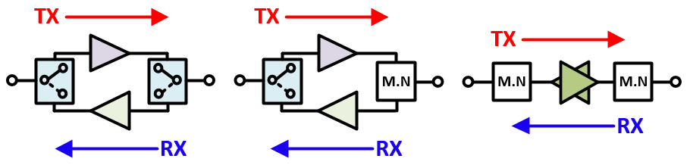
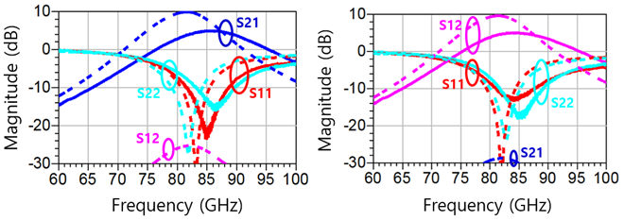
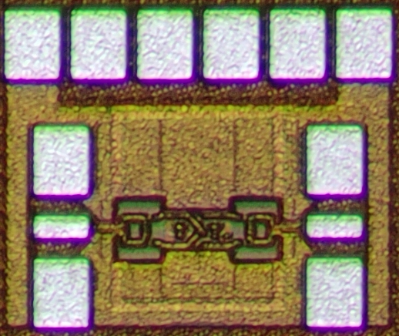
A E-­band Cascode Bi-directional Amplifier
With Neutralization in 28-nm CMOS
Kyu-Jong Choi and Byung-Wook Min
Department of Electrical and Electronic Engineering, YonseiUniversity, Seoul, Korea
Abstract
28-nm CMOS E-band cascode bi-directional amplifier
neutralization
Minimized sized by removing SPDT switch
Chip Size : 0.25 x 0.11 (0.03mm2)
Design Concept
Introduction
In phased array system, output power is decreased as the input power is divided among several elements
The reduction of output power is severe as the size of the array increase
To deliver sufficient power, interstage amplifiers is necessary
In TRx system, compensation circuits are needed for each Tx / Rx mode which make difficult the integration and require cost
Bi-directional amplifier is designed for enhancing the system integration and reducing the cost
Circuit Design
Enhance the gain by using the cascode structure
Securing stability and improving gain using neutralization capacitor
Securing reliability using DC block capacitor
Broadband matching using Balun
Schematic
Results
4.6 dB / 4.7 dB @ 86GHz measurement maximum gain
- 0.9 dBm simulated output compression point
31 mW Power consumption
Chip Microphotograph
Conclusion
Designed a small size bi-directional amplifier that does not use SPDT
Ensuring sufficient op1dB through system power budget
Gain reduction due to loss due to multi-stackup of MOM capacitor
Frequency shifting occurs due to inaccuracy in parasitic capacitance modeling of the transistor.
Scheduled to receive a Bi-directional amplifier chip that will produce similar performance to Simulation
Acknowledgement
The chip fabrication and EDA tool were supported by the IC Design Education Center(IDEC), Korea.

